Slide 1
Experiment Design
How do we find out that it works?

Slide 2




There are many strategies for dealing with customers
$$π1$$
$$π2$$
$$π3$$

Slide 3
Strategy = assignment of an action to a state
$$π1$$
$$π:S →a$$

Slide 4
S : possible states
Demographic characteristics
Age
Gender
Education
Occupation
...
Transaction statistics
Frequency of purchases
Number of transactions
Volume
Time since last transaction
...
Communication data
Last contact
Frequency of contacts
...
External data
Social media reviews
...

Slide 5
a : possible actions
Contact
Form/channel
SMS
E-mail
Phone
Moment
Offer
Discount
Amount
Decision
Acceptance of the application
…

Slide 6
We design a new way of doing things
Let’s call it a recommendation system

Slide 7
Our system recommends action a based on the state of the customer S
$$π1$$
$$π:S →a$$

Slide 8
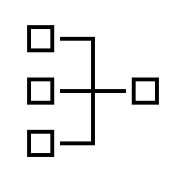
Its operation usually boils down to data transformation and application of business rules
Features
Model
Business Rule
$$π:S →a$$

Slide 9
Example models
Predictive modeling
- Classification:
Will he buy in the near term (e.g., 1 week)?
Will he churn?
Probabilities...
- Regression:
In how many days will he buy?
How much will she spend?
Modeling the impact of advertising on the customer (uplift)
Data analysis
- Segmentation
Demographic characteristics
Transactional statistics (RMF)
Predictive modeling results (e.g., probabilities)

Slide 10
Example rules
If
- The conversion probability generated by the predictive model is in the 1st quartile,
and
- the customer has already bought at least one product from us
and
- has not bought from us for 3 months
then
- let's call with a proposal of 30% discount

Slide 11
Models

Slide 12
The model is just one of several components of the recommendation engine
Features
Model
Business Rule
$$π:S →a$$

Slide 13
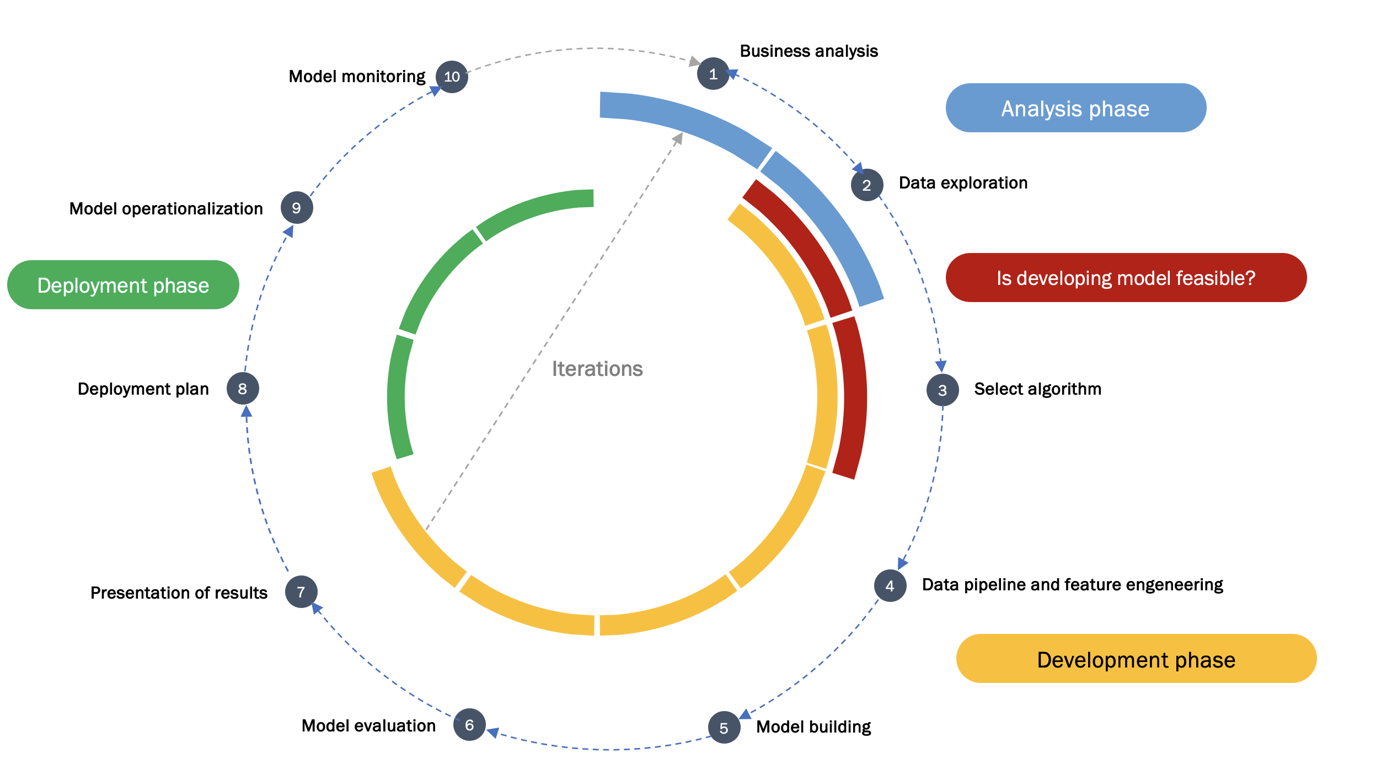
It is trained and evaluated on historical data

Slide 14
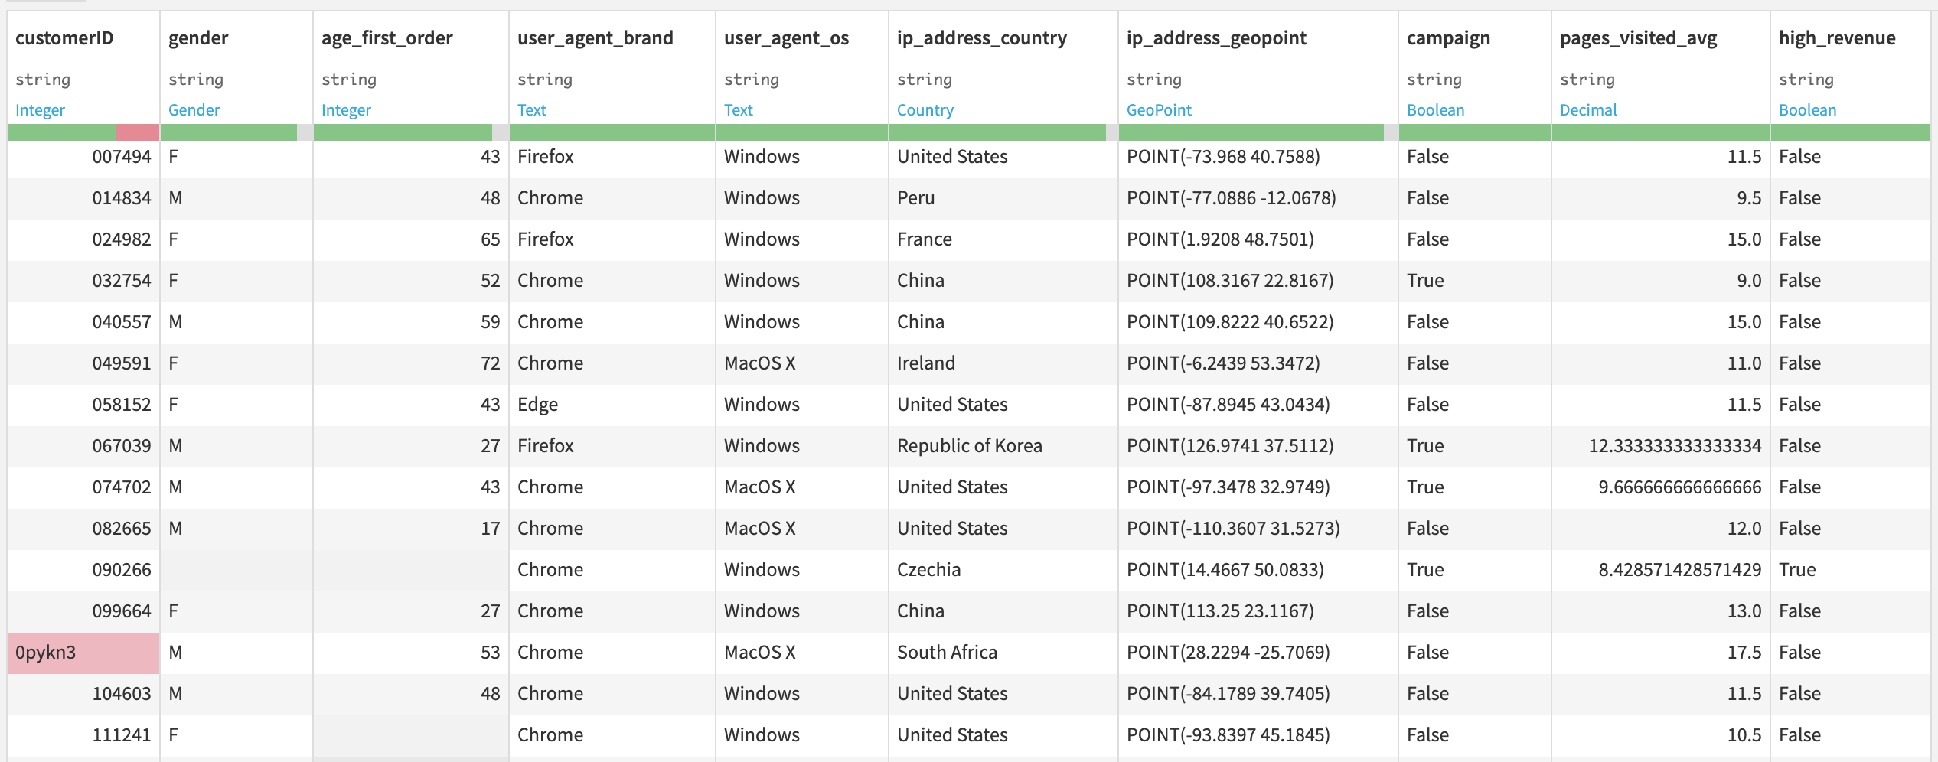
Requires a precise definition of the dependent variable... What do we want to predict?

Slide 15
… and the selection and engineering of features

Slide 16
As a result of training, we get many models. We choose the best one using some statistical measures
ROC AUC?
Accuracy?
RMSE?
F1, precision, recall?

Slide 17
But model is only a part of the whole story
It needs to be implemented

Slide 18

The strategy generates only a recommendation for action....
S
$$π1:S →a$$
S’

Slide 19



This recommendation should be implemented, and information about the implementation transferred to the system
S
$$π1:S →a$$
S’
$$π1$$

Slide 20
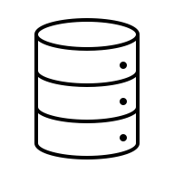


This requires the right architecture
State
Action
$$π1$$
Transactions
Communications External data…
Recommendation engine
Implementation

Slide 21
OK. But how to check if it really works?
We need experiments

Slide 22
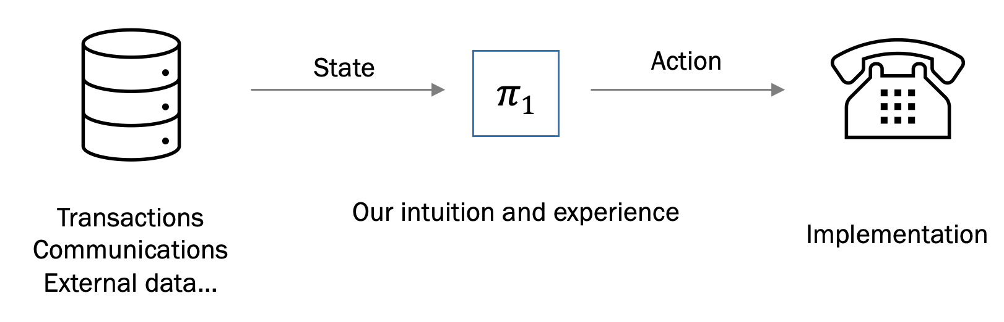
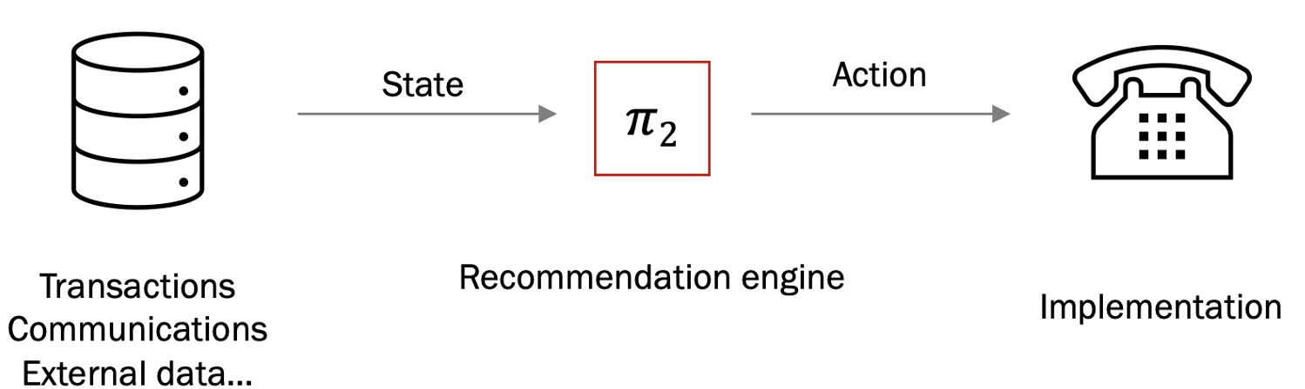
How to check if the change is REALLY for good?
The ”old way” of doing things
The ”new way” of doing things

Slide 23
First, we need to define the success…
Average CTR (Click-Through Ratio)?
Average CR (Convertion Rate)?
Average profit per customer?
Average revenue per customer?
…

Slide 24






Next, design, run, and evaluate the experiment
population
Sample How large?
$$π0$$
$$πo →r0$$
$$r0>? r1$$
$$π1$$
$$π1 →r1$$

Slide 25
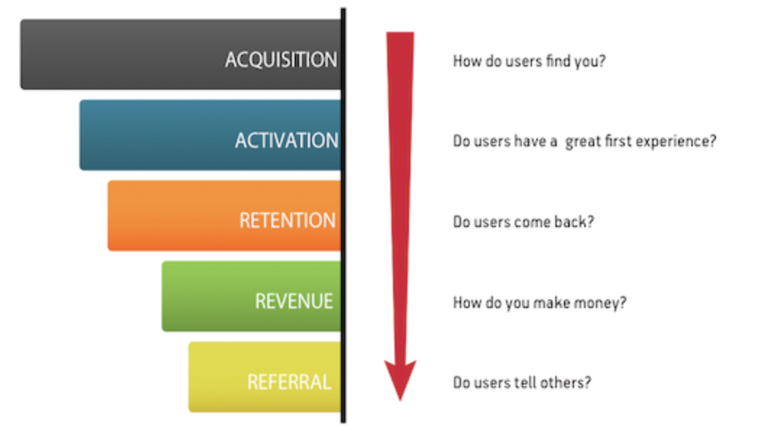
Determine Your KPIs
Must be calculable from historical data
Transactions
Communications
External data
Should meet the characteristics of OEC (Overall Evaluation Criterion) > Trustworthy online Controlled Experiments, Kohavi et al.
Do you know Pirate Metrics?
You can also check e.g. https://startupdevkit.com/types-of-startup-kpis-metrics-to-measure-with-examples/

Slide 26
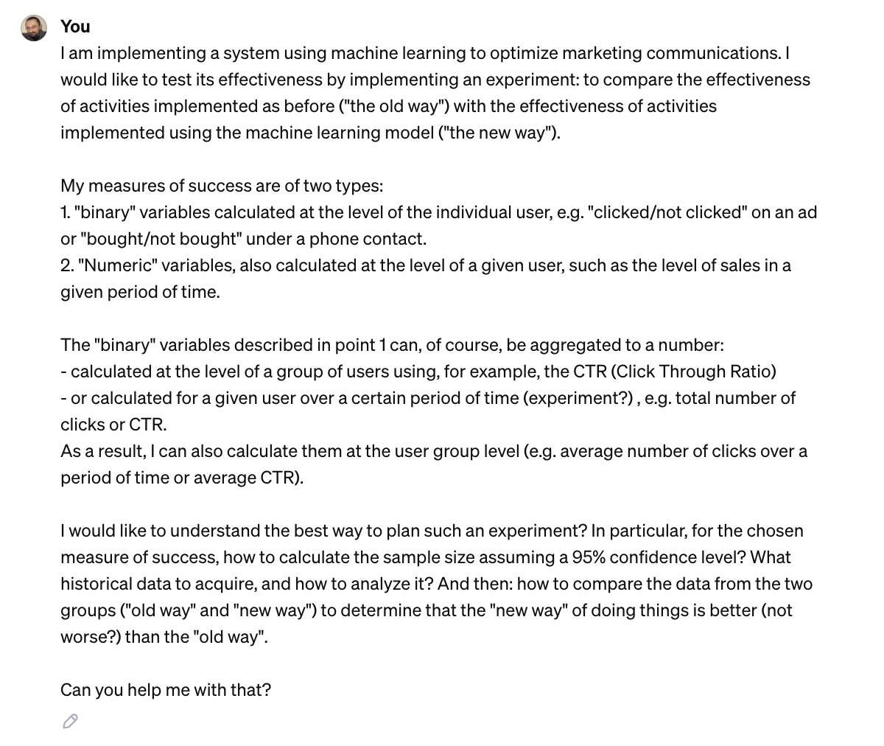
Design and run the experiments
There are, typically, two types of KPIs:
- „binary”: bought/didn’t buy; clicked/didn’t click, …
- „numerical”: how much? how many?
Your decisions:
How do we measure the success?
What is the change we suppose to achieve? e.g. 2% increase in CTR; 10% increase of mean sales
How confident we want to be about the change?
Confidence level? Statistical power?
You can get suport from online calculators, or ChatGPT...

Slide 27
Iterate
And never stop…
Formulate hypotheses
Design the experiment
Conduct the experiment
Evaluate results
Suggest improvements

Slide 28
Over time, the model becomes obsolete in such a case it needs to be re-trained
Accuracy
Acc_{min}
Czas

Slide 29
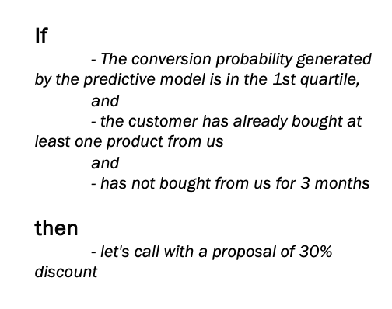
Business rules may also become outdated
???
???_{min}
Czas
But how to check it?

Slide 30
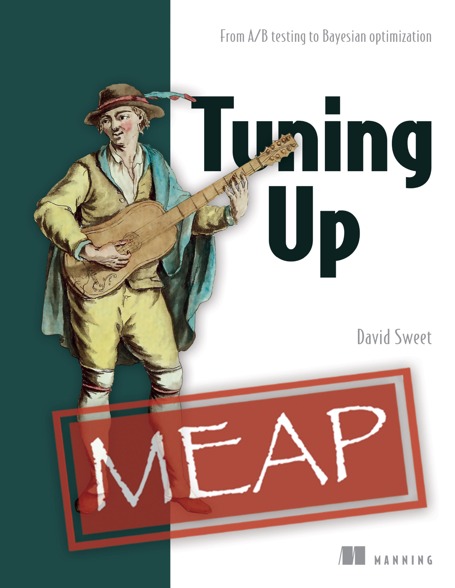
Costs?
After some time Your products will be close to perfection
That means that even 90% of Your new ideas will be worse than Your current way of doing things.
In that case, Your main cost of running experiments will be Your customers (un)satisfaction with worse products (new way will be worse than old way).
What to do?
Optimize Your experiments.
Thompson Sampling, Reinforcement Learning, etc.

